Slide 1

Department of BES-II
BASIC ELECTRICAL & ELCTRONIC CIRCUITS (BEC)
COURSE CODE : 23EC1203
Topic:
VOLTAGE REGULATOR-LM723
Session – No.22

Slide 2



AIM OF THE SESSION
To familiarize students with the basic concept of LM723 and its importantance.
INSTRUCTIONAL OBJECTIVES
This Session is designed to:
Demonstrate the concept of voltage regulator
Describe the working principle of LM723
List out the characterstics of LM723
Describe the importantance of LM723
LEARNING OUTCOMES
At the end of this session, you should be able to:
Define the voltage regulator
Describe the LM723
Summarize the overall concept of LM723

Slide 3
SESSION INTRODUCTION
There are various types of voltage regulators for getting a regulated power supply like 7812, 7805, etc. However, all these regulators provide a fixed value output. For inconsistent voltage regulation, an LM317 IC voltage regulator.
LM723 IC is a changeable voltage regulator, used in the series regulator application with 150mA current o/p without exterior pass transistor.
When we utilize an external transistor, then it supplies 10A current to drive the load. The input voltage supply is maximum 40V & its o/p voltage ranges from 3volts to 40volts.

Slide 4
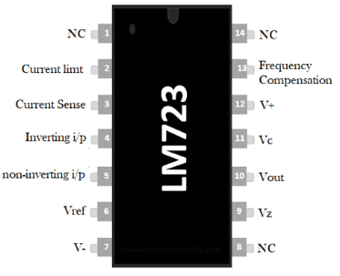
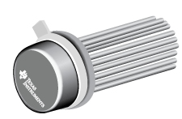
SESSION DESCRIPTION

Slide 5
SESSION DESCRIPTION (Cont..)
Pin1 (NC): Not connected
Pin2 (Current Limit): This pin is used to limit the current
Pin3 (Current Sense): This pin is used in foldback application as well as to limit the current
Pin4 (Inverting Input): This pin provides stable o/p voltage
Pin5 (Non-inverting Input): This pin is used to supply a reference voltage to the inside of the operational amplifier.
Pin6 (Vref): This pin provides an almost 7v reference voltage
Pin7 (-Vcc): GND (Ground) Pin
Pin8 (NC): Not connected
Pin9 (Vz): This pin is generally used to make negative regulators
Pin10 (Vout): This is the o/p pin
Pin11 (Vc): This is the series pass transistor’s collector input. Generally, it is connected directly to the +ve voltage supply if an exterior transistor is not used.
Pin 12 (V+): This is the input of the positive supply
Pin13 (Frequency Compensation): This pin assists in decreasing noise with a 100pf capacitor
Pin 14 (NC): Not connected.

Slide 6
FEATURES OF LM723
The features of the LM723 include the following.
The unnecessary o/p current will be 150mA without using an exterior pass transistor.
The maximum input supply voltage will be 40V.
It offers modifiable o/p from 3volts to 37volts.
These ICs are used to make switching & linear regulator.
It supplies 10A o/p current with the help of an external pass transistor.
These ICs are used for different operations such as positive, negative, series, floating, and shunt.

Slide 7
SPECIFICATIONS
Specifications of LM723
The maximum i/p voltage is 40v
The reference voltage is always 7 volts
Ripple rejection is 74 dB
The current supply from Vz pin is 25mA
The output voltage ranges from 3volts to 37 volts
The range of operating temperature will be from -55°C to +150°C
The current supply from Vref pin is 15mA
The line and load regulation of 0.01%Vout & 0.03% Vout

Slide 8
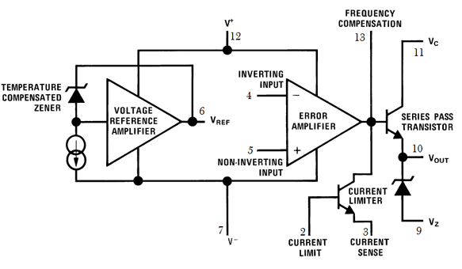
BLOCK DIAGRAM

Slide 9
BLOCK DAIGARM (cont..)
The block diagram can be explained by separating it into two blocks namely the error amplifier and the reference voltage generator.
In the reference block, a Zener diode is being forced to work at set point, so the o/p of the more zener is a permanent voltage with a stable current supply which arrives to produce a stable voltage (7.15V) along with an amplifier on the Vref pin of the IC.
In the error amplifier block, it includes a series pass Q1 transistor, an error amplifier, & a transistor which limits the current. This amplifier is used to contrast the o/p voltage which is given at inverting i/p terminal throughout feedback toward the Vref-reference voltage given at the non-inverting terminal.
The two connections internally not offered & so have to be externally offered in accordance with the required output voltage. The conduction of the transistor Q1 is controlled by the error signal. It is this transistor that controls the output voltage.

Slide 10
BLOCK DAIGARM (cont..)
The advantages of LM723 voltage regulator include proven, low noise, the voltage range is wide, support for external pass transistors, recompense by the user, extremely flexible, complete temperature range accessible, and economical.
The disadvantages of LM723 voltage regulator include difficulty, current limiting is not exact, current limiting is sensitive to overload, lowest dropout voltage, least regulated o/p voltage, error amplifier gain is Moderate, error amp bias current, and be careful when using MOSFET pass transistors.

Slide 11

ACTIVITIES/ CASE STUDIES/ IMPORTANT FACTS RELATED TO THE SESSION
Battery Charger:
Activity: Create a battery charger circuit using the LM723 to regulate the charging voltage for rechargeable batteries.
Case Study: Investigate the charging characteristics and efficiency of the LM723-based battery charger for different types of batteries, such as lead-acid or NiMH.
Voltage and Current Regulator:
Activity: Combine the LM723 with external components to create a dual-mode regulator that regulates both voltage and current.
Case Study: Analyze the advantages of having a voltage and current regulation capability in a power supply, especially for driving loads with dynamic power requirements.

Slide 12
EXAMPLES
Battery Charger:
The LM723 can also be used in battery charger circuits. In this example, the LM723 is configured to regulate the charging voltage for a lead-acid battery. The feedback loop adjusts the charging voltage to the desired level, and the current is limited by the resistor (R3) and the voltage drop across the sense resistor (R4).
R1 and R2: Resistors for setting the reference voltage.
R3: Current-limiting resistor for setting the charging current.
R4: Sense resistor for current sensing.
C1 and C2: Input and output capacitors for filtering.

Slide 13
SUMMARY
It is an adjustable voltage regulator and the applications of LM723 mainly include a temperature controller, shunt and current regulator. It provides a high range of o/p voltage & current equal to 10A by just inserting a sequence pass transistor through it, by including an extensive range of working temperature.
Thus the integrated circuit capable to withstand for long to use like linear otherwise switching kind regulator. However, this integrated circuit is particularly designed for series regulator function

Slide 14
SELF-ASSESSMENT QUESTIONS
What is the primary function of the LM723 voltage regulator?
A. Digital signal processing
B. Voltage amplification
C. Voltage regulation
D. Audio signal modulation
Which component is typically used to adjust the output voltage in an LM723 voltage regulator circuit?
A. Inductor
B. Resistor
C. Capacitor
D. Transistor

Slide 15
TERMINAL QUESTIONS
In an LM723-based voltage regulator circuit, what is the purpose of the "Comp" terminal?
What does the "Vin" terminal of the LM723 voltage regulator connect to?
Which terminal of the LM723 is used to set the maximum output voltage?
What is the purpose of the "Vadj" terminal on the LM723 voltage regulator?
Which terminal of the LM723 is connected to the reference voltage for setting the output voltage?

Slide 16
REFERENCES FOR FURTHER LEARNING OF THE SESSION
Reference Books:
1. 1.John Bird. Electrical Circuit Theory and Technology, Routledge publishers, 6th edition,
2. Electronic Devices and Circuit Theory 12th Edition - Robert L. Boylestad
Sites and Web links:
1. https://circuitdigest.com/electronic-circuits/lm723-voltage-regulator-circuit-diagram
2. https://www.circuits-diy.com/lm723-adjustable-voltage-regulator-30v-circuit/

Slide 17
THANK YOU
Team – BEEC

